Slide 1
Javascript Training
The best marketing tool for your business.

Slide 2
What is Javascript
High Level, Interpreted programming language
Conforms to the ECMAScript specification
Multi-paradigm
Runs on the client/browser as well as on the server (Node.js)

Slide 3
Why learn Javascript?
It is the programming language of the browser
Build very interactive user interface with frameworks like react
Used in building very fast server side and full stack applications
Used in mobile development (React Native, Native Script, Ionic)
Used in desktop application development (Electron Js)

Slide 4
What we will be learning
Variable & Data types
Arrays
Object Literals
Methods for strings, Arrays, Object etc
Loops - for, while, for…of, forEach, map
Functions (normal & arrow)
DOM Selection
DOM Manipulation
Events
Fetch API & AJAX
Basic Form Validation

Slide 5
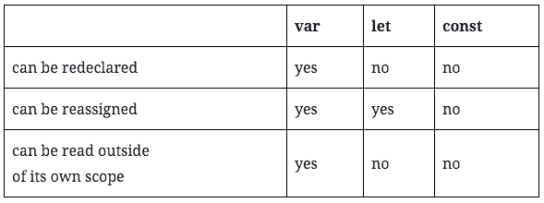
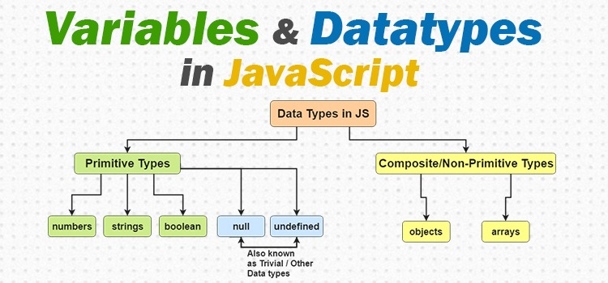
Variables & Data types

Slide 6
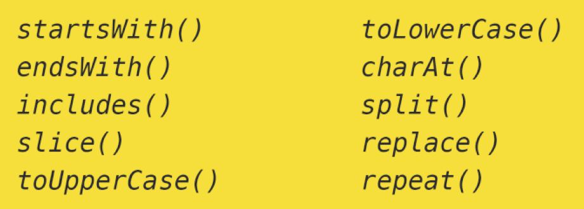
Strings & String Methods
Some of the commonly used inbuilt string methods

Slide 7
Arrays
An array can hold many values under a single name, and you can access the values by referring to an index number. Below are some of the methods which are commonly used
toString()
join()
pop()
push()
shift()
unshift()
concat()
splice()
slice()

Slide 8
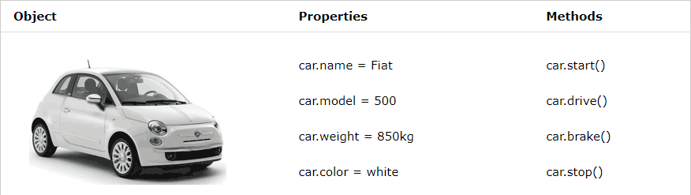
Object Literals
An object literal is a list of zero or more pairs of property names and associated values of an object, enclosed in curly braces ( {} )

Slide 9
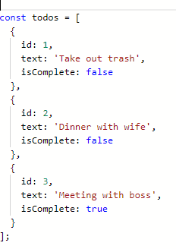
Arrays Of Objects & JSON

Slide 10
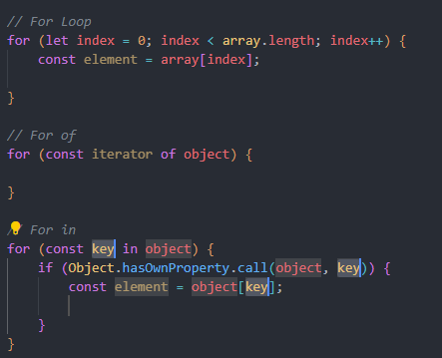
Loops
for - loops through a block of code a number of times
for/in - loops through the properties of an object
for/of - loops through the values of an iterable object

Slide 11
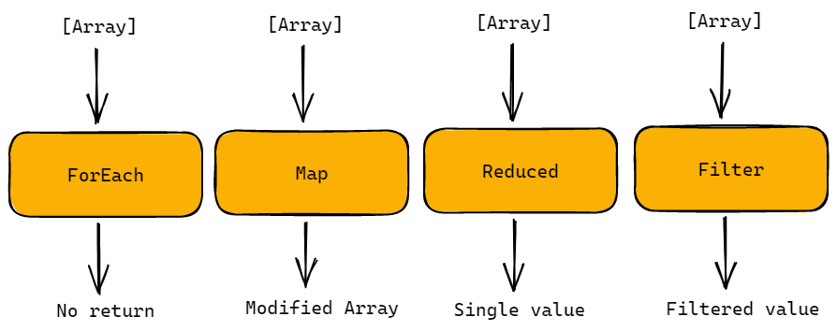
High Order Array Methods

Slide 12
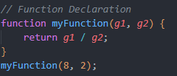
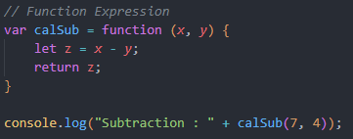
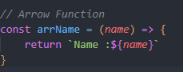
Types of Functions
Function declaration
Arrow Functions
Function Expression

Slide 13
JavaScript Selectors
QuerySelector Methods:
The querySelector() Method The querySelectorAll() Method
GetElement Methods:
The getElementById() Method The getElementsByTagName() Method The getElementsByClassName() Method

Slide 14
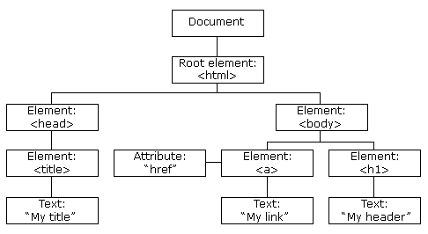
JavaScript DOM
When a web page is loaded, the browser creates a Document Object Model of the page.
The HTML DOM model is constructed as a tree of Objects:

Slide 15
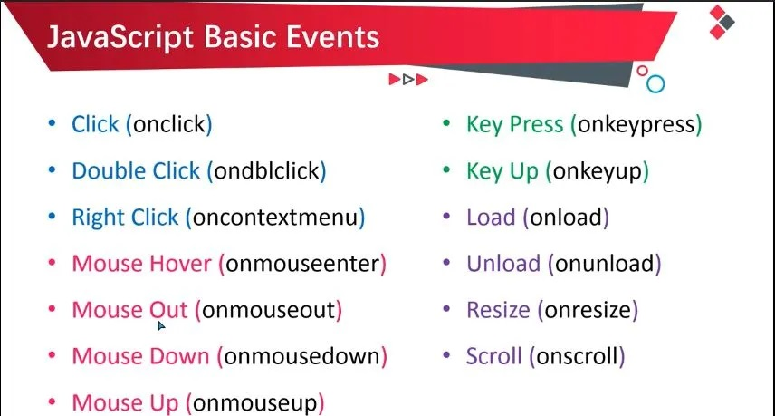
JavaScript Events
Commonly used JavaScript Events

Slide 16
Traversing the DOM
Some of the commonly used way to Traverse in the DOM
parentNode
childNodes[nodenumber]
firstChild
lastChild
nextSibling
previousSibling

Slide 17
DOM Elements
This is the programming interface that allows us to create, change, or remove elements from the document. Commonly used DOM elements Method
InnerText
InnerHTML
InsertBefore
InsertAfter
append
appendChild()
Prepend

Slide 18
What’s next…
Based on the concepts which we have learnt I will be developing a form validation which will summarize how things work in DOM level

Slide 19

Thank you!
Moving further we will be having a interactive session in which you will be working on Mini Project just for the understanding purpose.

